Slide 1
JRA1.1 Requirements gathering
Current status and plans
Peter Solagna
JRA1.1 Task leader
EGI.eu
Milano, AARC General meeting

Slide 2
Overview
DJRA1.1 overview
Interviews with the stakeholders
Analysis and next steps
MJRA1.1 Technologies analysis

Slide 3
DJRA1.1 Requirements analysis

Slide 4
Requirements gathering: the process
Already available requirements:
FIM4R
TERENA AAA study
Surveys
Circulated among the AARC communities, FIM4R ML, and other targets
Open questions inspired to the hot topics of the existing documentation
Interviews
Focused interviews for the DJRA1.1:
EGI
ELIXIR
EUDAT
GÉANT Project
Dutch consortium of the National and University Libraries
To be continued..
DJRA1.1
DJRA1.1
DJRA1.1

Slide 5
Survey topics
AAI Current status
What is your community’s current experience with AAI?
Benefits, perceived barriers and user experience
Technical solutions adopted
Current coverage of federated AAI in the community
Requirements
Type of IdPs relevant for the community
How AAI penetration can be improved?
Technical requirements
Preferred technology, attribute release, LoA management, unique identifiers, group management, type of access

Slide 6
Surveys received
BioVel
DARIAH
EISCAT
WLCG
EPOS
Photon and neutron (Umbrella)
ELIXIR
CLARIN
EGI
EUDAT
D4Science
PSNC
FMI
Libraries and education

Slide 7
Requirements analysis in DJRA1.1
How the deliverable is structured:
Inputs from the stakeholders:
Summary of the requirements available before AARC
Summary of the requirements gathered through the surveys
Summary of the individual interviews
Requirements analysis
Architectural and technical requirements
Policies and best practices

Slide 8
DJRA1.1: Summary of the requirements from past activities
FIM4R
High priority
Medium priority
TERENA AAA Study
Technical recommendations
Actions required
Main stakeholders
Policy recommendations
Actions required
Main stakeholders

Slide 9
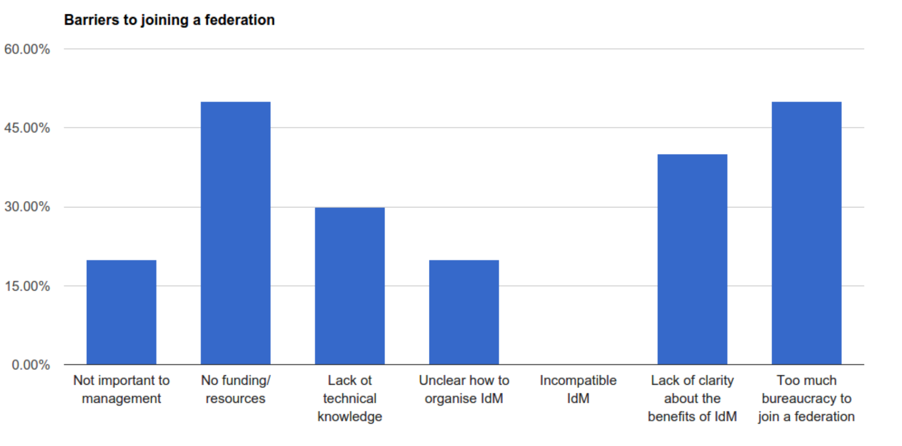
DJRA1.1: current status, barriers

Slide 10
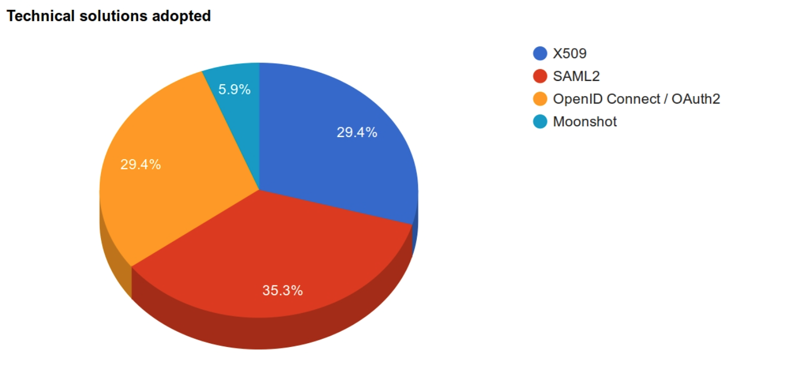
DJRA1.1: current status, technologies
8 out of 10 communities answered in the survey that they have already a technical solution in place

Slide 11
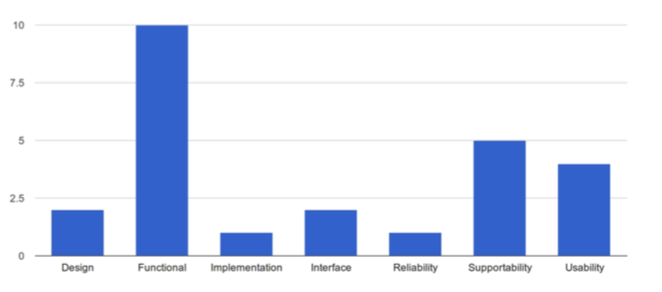
DJRA1.1: requirements, type of requirements

Slide 12
MJRA1.1: The requirements 1/2
Guest Identities / Levels of Assurance/ R2 Homeless users
R3 Different Levels of Assurance
R13 Step-­up authentication
R16 Social media identities
R17 Integration with e-­Government infrastructures
User Identification
R8 Persistent user identifiers
R9 Unique user identities
R10 User-­managed identity information Source:
Attributes: Groups and Authorisation
R4 Community-­based authorisation
R5 Flexible and scalable attribute release policies
R12 User groups and roles
R_P_5 Semantically harmonised identity attributes
Attributes: Release
R6 Attribute aggregation / Account linking
R_P_3 Sufficient attribute release

Slide 13
MJRA1.1: The requirements 2/2
Technology requirements
R7 Federation solutions based on open and standards
R14 Browser & non-­browser based federated access
R15 Delegation
Privacy, legal issues, and policies
R10 User-­managed identity information Source
R18 Effective accounting
R_P_1 Policy harmonisation
R_P_2 Federated incident report handling
R_P_7 Best practises for terms&conditions
Training
R1 User and Service Provider friendliness
R_P_4 Awareness about R&E federations
R_P_6 Simplified process for joining identity federations The bureaucracy involved in joining identity federations should be reduced

Slide 14
How can requirements be prioritized?
Surveys, interviews and previous documentation produced a consistent set of requirements
Still manageable and non contradicting ☺
To discuss within JRA1 how much these requirements need to be prioritized, if any need to be discarded.
Prioritization by popularity is one factor to be considered
Individual interviews with the stakeholders are another useful tool for periodization
Document user stories to analyze how critical the requirements are for the workflows of a stakeholders

Slide 15
Individual interviews with the AARC stakeholders

Slide 16
Why individual interviews
Open discussion with the stakeholders, not limited by the boundaries of a survey
But surveys have been a useful tool to gather quickly and consistently material for the deliverable.
Describe the user stories
What the users need to do
What the service providers need to know
How the workflows of the services are using authentications/authorization
Describe the expectations for AARC outputs

Slide 17
Already performed interviews
Interviews part of the DJRA1.1:
EGI
EGI Workflows
EGI critiacl/non-critical requirements
EGI AAI plans for evolution
ELIXIR
Requirements and use cases on which the ELIXIR AAI is being designed
EUDAT
Plans for the EUDAT AAI B2Access
Requirements
GÉANT Project
VO aaS
Cloud Activities
Enabling user experience
Dutch consortium of the National and University Libraries
Status and penetration of AAI

Slide 18
Next steps with the interviews
JRA1.1 plans to continue with the open interviews until the end of the year
The outputs of these interviews will be summarized on the JRA1.1 wiki
Candidates for the future interviews:
CERN
Libraries
ESFRIs
EGI is in contact with the ESFRIs participating to the Competence Centres
…

Slide 19
Feedback needed-1!
Who else should we interview?
Which questions are critical and should be asked explicitly?

Slide 20
MJRA1.1 Technologies analysis

Slide 21
MJRA1.1: AAI technologies analysis
Table of content available on google doc:
Existing AAI and available technologies for federated access.
Assessment on the AAI technologies operated by the R&E: Research Infrastructures, e-infrastructures
Goal of the document:
Provide information about the technologies supporting AAI
Standards and implementations
Tools
Provide comparative analysis of these technologies grouped by capability
Where to start?
Technologies and tools reported in the surveys
Interviews and other sources of information to gather the AAI plans of the research infrastructures/e-infrastructures
AARC knowledge base ☺

Slide 22
MJRA1.1: The topics
Authentication standards and implementation
Authorization and group management technologies
Interoperability enabling tools
Attribute aggregators
Token translations services
Existing documentation and sources of information:
Magic deliverable: Assessment of the existing Group Management Standards and Value Services for Global Communities
GÉANT Voaas market analysis
GÉANT omparison of Authentication and Authorization Infrastructures for Research

Slide 23
MJRA1.1: Authentication technologies
Relevant standards
SAML2
X.509 certificates and proxies
OpenID Connect/Oauth
XACML
ABAFB (Moonshot)
SCIM
VOOT
CIFERm
Implementations
SimpleSAMLPHP (SAML2)
Moonshot (ABAFB)
LCMAPS (X.509)
Shibboleth

Slide 24
MJRA1.1: Authorization and attributes management services
Attribute management
HEXAA
UNITY
PERUN
OpenConext
VOMS
Comanage Grouper
Policy management
ARGUS

Slide 25
MJRA1.1: Interoperability-enabling tools
Attribute aggregators (aggregating IdPs and Attribute authorities)
OpenConext
SimpleSAMLPHP
Unity
Perun
HEXAA
Token translation services
CILOGON
TCS
STS
Unity (?)
SImpleSAMLPHP (?)

Slide 26
MJRA1.1: How to compare technologies and tools
Compare by: Features/capabilities
JRA1.1 requirements: tools supporting the use cases
License
Sustainability
Additional features, e.g.tools supporting multiple standards
Compare by: Usability
This is the next step after MJRA1.1
Usability will be tested in the pilots under SA1

Slide 27
MRA1.1 timeline
Milestone due for the end of the year
Still some contributors needed for some the tools/technologies.
Currently writing the sections of the TOC/Preparing the summary comparison tables.
First draft: mid November
Final version: mid December

Slide 28
Feedback needed-2!
Are the topics comprehensive?
Should technologies/tools be added or removed from the TOC?
Would you like to contribute to the document?

Slide 29
Thanks!
For any comment or question, please contact me: peter.solagna@egi.eu

