Slide 1
Example Use Case for Attribute Authorities and Token Translation Services - the case for eduGAIN
Andrea Biancini

Slide 2
The architecture
eduGAIN is a SAML based identity federation, in this scenario Attribute Providers has been implemented leveraging two main protocols:
the Attribute Authority role for a SAML federation entity, for orline information flows to be retrieved during user login;
the VOOT protocol (based on SCHIM) to describe groups and memberships offline from user authentication.

Slide 3
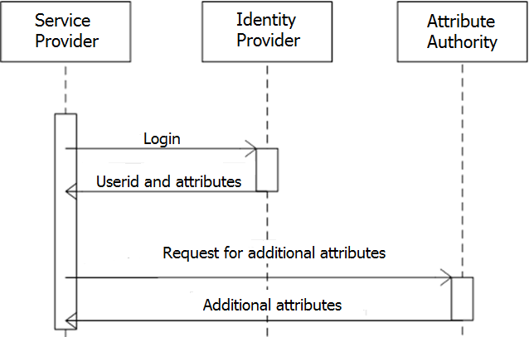
Interactions - AA

Slide 4
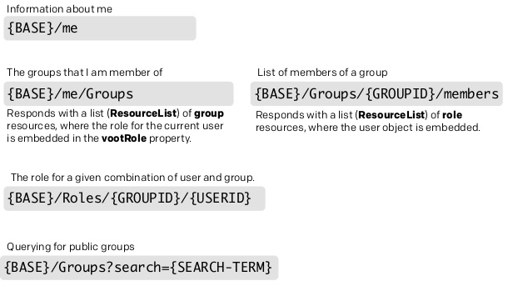
Interactions - VOOT
VOOT is a protocol for exchanging group information externally to applications.
Very simple API:

Slide 5
Benefits and issues
The architecture shown permitted to:
Distribute the responsibility to provide information about known users to different subjects within the federation.
Decouple authentication and authorization processes.
AAs in eduGAIN still have some significant limitation:
AAs still have some issue regarding privacy and security.
User enrolment must be supported to reduce effort.

Slide 6
Conclusions, challenges addressed
Permit delegation of the management of user information in a clear and secure way.
Provide new architectural elements that could seamlessly integrate with existing architectures (to simplify technical adoption of such a solution by all the participants to the federation).
Leverage the existing federations in building the reciprocal trust, needed to guarantee security.

