Slide 1
Operational Security Update
Authentication and Authorisation for Research and Collaboration
Hannah Short
Task Leader TNA3.1 Operational Security
CERN Computer Security
AARC Project Meeting
21 – 23 November 2017, Amsterdam

Slide 2
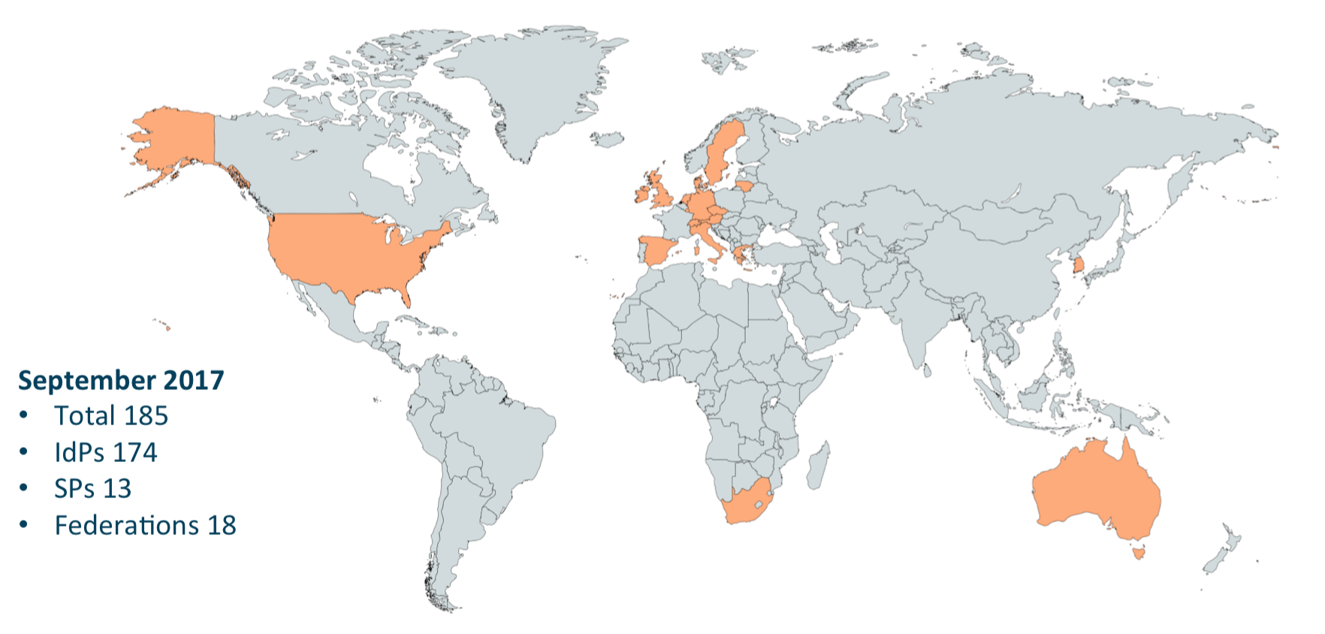
Background
What have we done in AARC1?
Published Sirtfi (Security Incident Response Trust Framework for Federated Identity)
Helped Sirtfi adoption (partnered with NA2)
Proposed a framework for coordinated security incident response: https://aarc-project.eu/wp-content/uploads/2017/02/DNA3.2-Security-Incident-Response-Procedure-v1.0.pdf
What are we doing in AARC2?
Putting Sirtfi and community incident response into practice
Testing event signaling mechanisms
Considering alternative Sirtfi adoption options
Analysing security coverage of the R&E community

Slide 3
TNA3.1 Partners & Input
FIM4R^{[1]}
[1] https://cdsweb.cern.ch/record/1442597

Slide 4
AARC2 TNA3.1 Milestones & Deliverables
Task | Due Month
MNA3.3 – Incident Response Test Model for Organizations | 9 (1 Feb 2018)
Skeleton | ~ December 2018/January 2017
DNA3.2 - Report on Security Incident Response | 22 (1 Jan 2019)
SP Endorsements of Sirtfi | Done (see https://refeds.org/sirtfi)
Sirtfi Registry Requirements | ~ December 2017
Trust Group Coverage | ~ February/March 2018

Slide 5
Ongoing Efforts – Sirtfi Registry
Proposed @ TIIME 2017
Next
Then
Now
Possibly taken onto work plans of GN4
May be of interest to the R&E Community in other settings
Discussed at TechEx 2017
Draft started by REFEDS Sirtfi WG
FIM4R
Federations have been found to be not flexible enough to support Research Communities’ needs for Trust Frameworks
Becoming more accepted to have additional sources of authoritative information
“How” and “Where” remain…

Slide 6
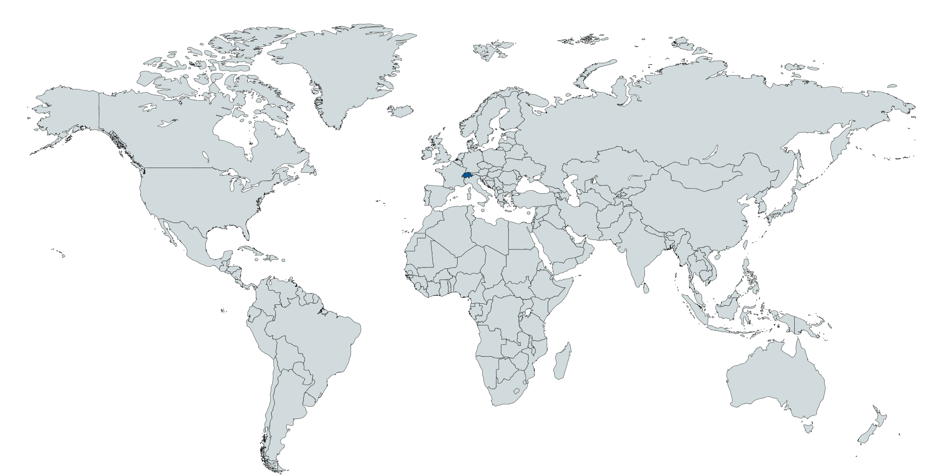
Ongoing Efforts – Trust Group Coverage
Multiple groups exist
Infrastructures
National bodies
Independent Operational Trust Groups
Groups (may) provide
Threat Intelligence
Incident Response Communication and Assistance
Analysis needed to identify where the R&E community needs links
Ops Trust
XSEDE
EGI CSIRT
REN-ISAC
TF-CSIRT
PRACE
OSG
DISCLAIMER: This is not a definitive picture!!!!

Slide 7
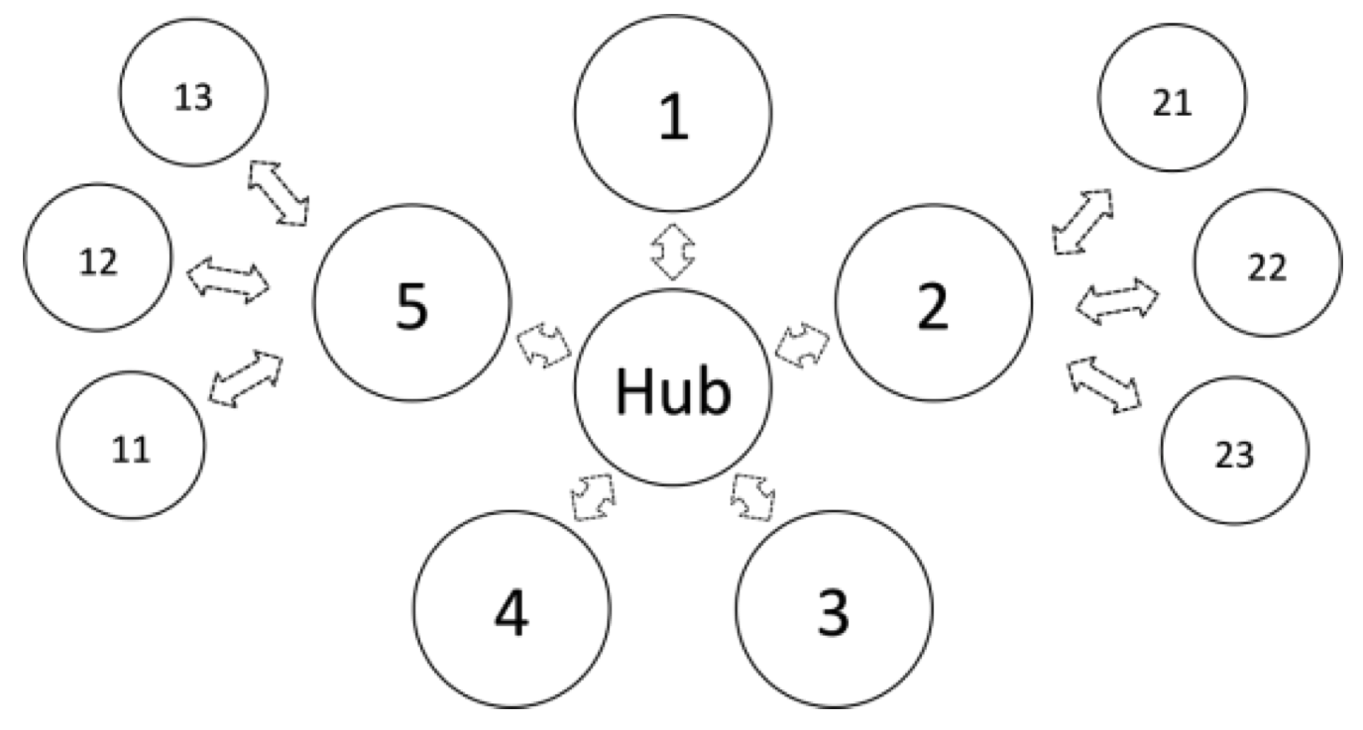
Ongoing Efforts – Incident Response Test Model for Organizations
AARC Proposal was for a nested approach to incident response
Use Federations as trust bridges between unknown entities
How should we test the incident response flow?
Can we automate it somehow?
Which parties are essential?

Slide 8
Ongoing Efforts – Incident Response Test Model for Organizations
Looking for volunteers
IdPs
Fed Ops
eduGAIN support platform
What?
Participate in tests
Email based
Possibly other channels
When?
December/January
NA3 WANTS YOU FOR INCIDENT RESPONSE

Slide 9
hannah.short@cern.ch

